Slide 1

Change Detection and Time Series Analysis
Jeffrey S. Evans, Ph.D.
Senior Landscape Ecologist
Conservation Lands/DbyD

Slide 2

Spatial Analysis in R: An introduction to data manipulation, spatial data analysis and statistical modeling Day 4 Change detection and time-series analysis
Jeffrey S. Evans, Ph.D.,
Senior Landscape Ecologist & Biometrician
The Nature Conservancy | Protected Lands Science
Visiting Professor | University of Wyoming | Zoology & Physiology
Laramie, WY | jeffrey_evans@tnc.org | (970) 672-6766

Slide 3
Some advances in raster change detection for continuous process (we are way beyond Δ)

Slide 4
Change Detection
Desirable characteristics in change detection methods
Accounting for spatial variability
Weights (i.e., Fuzzy Set Theory, Kappa)
Thresholds (change by defined percent)
Intensity (i.e., Wavelets)
Spatial structure (autocorrelation)
Results are quite variable and very different than image differencing. Selected method depends on question!

Slide 5
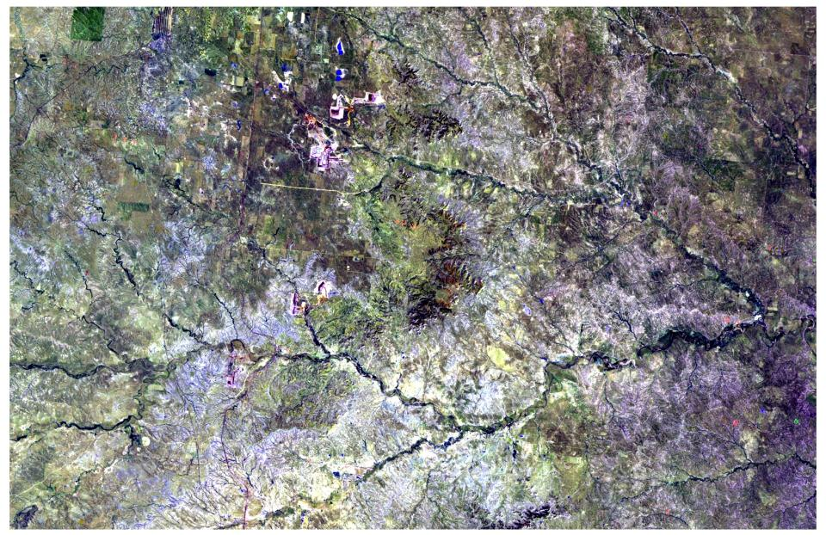
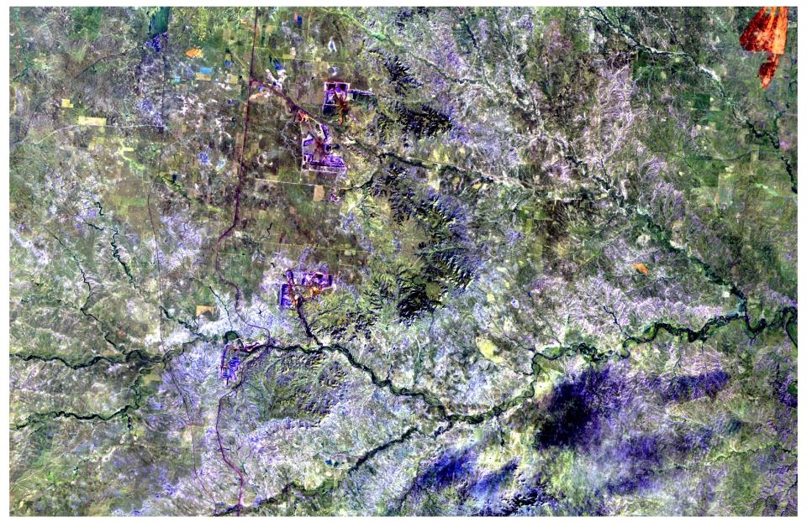
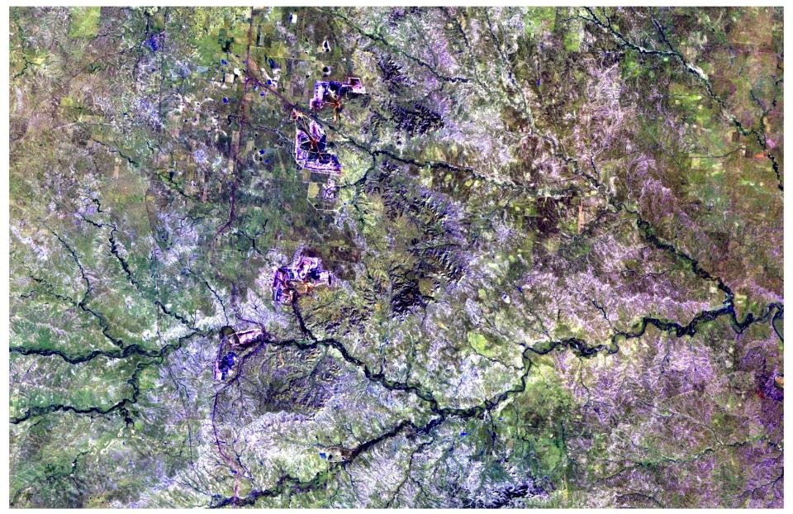
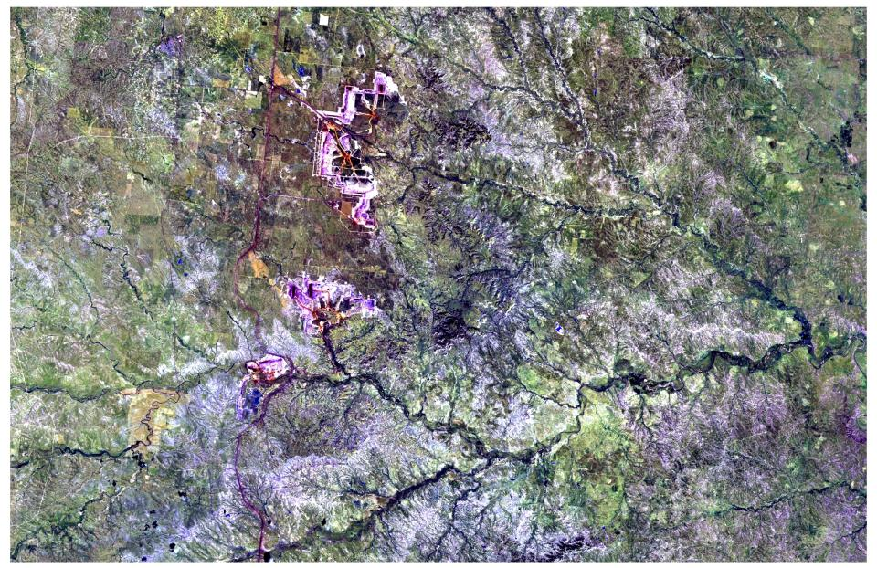
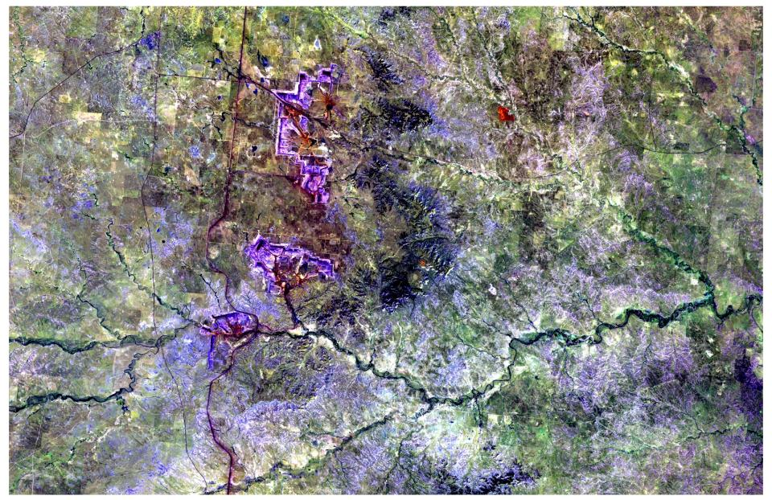
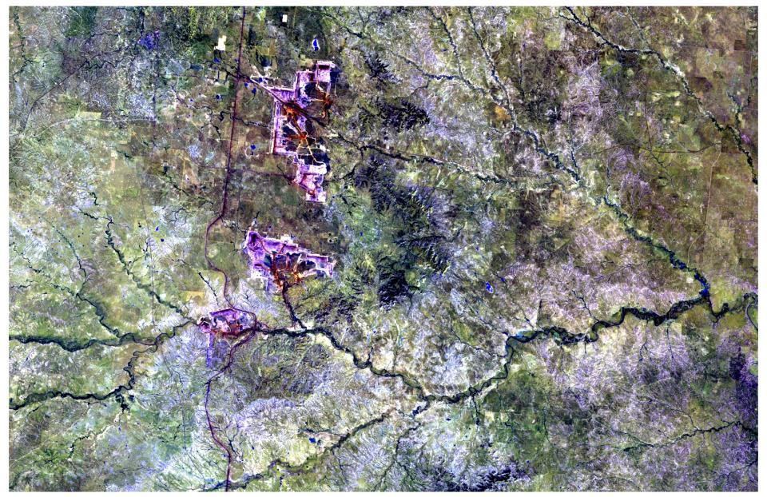
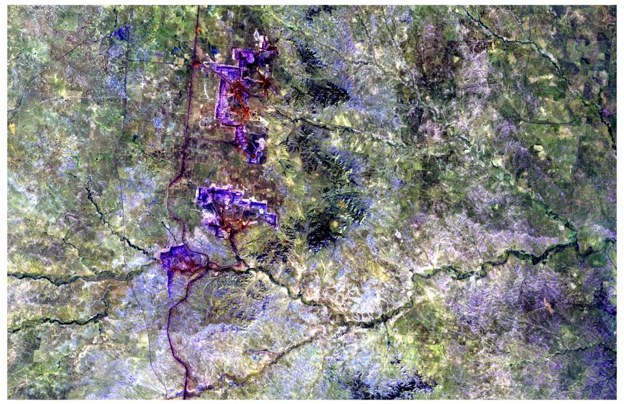
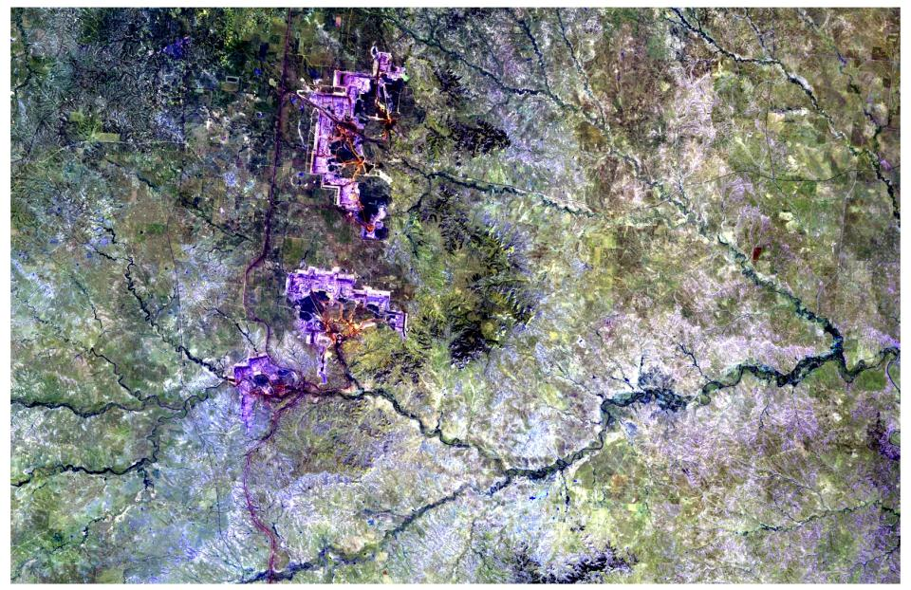
Landsat TM5 (Bands 7,2,5 Compost) Animation 1990-2007
1990
1994
1997
2000
2002
2003
2006
2007

Slide 6
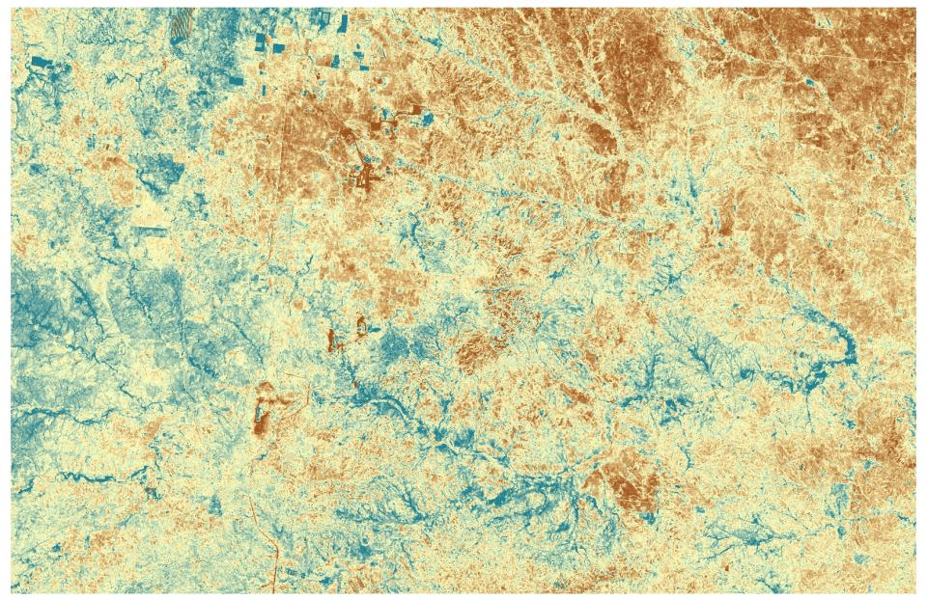
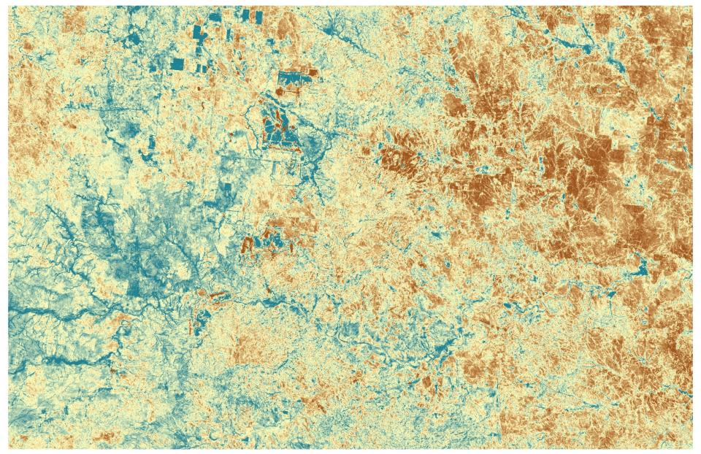
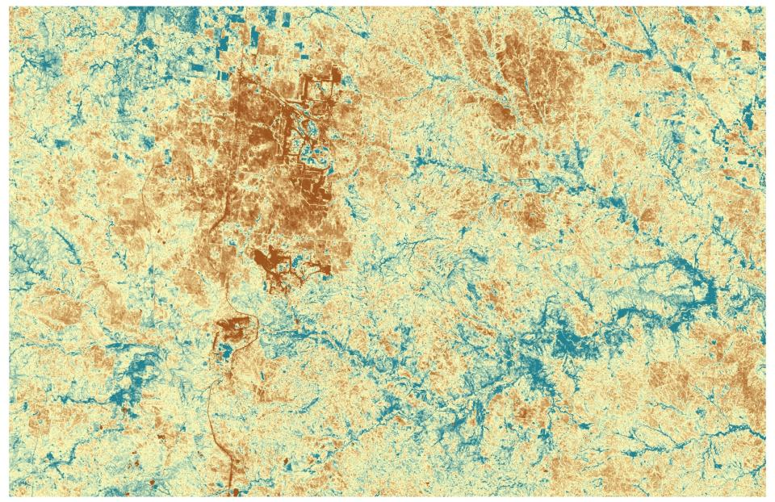
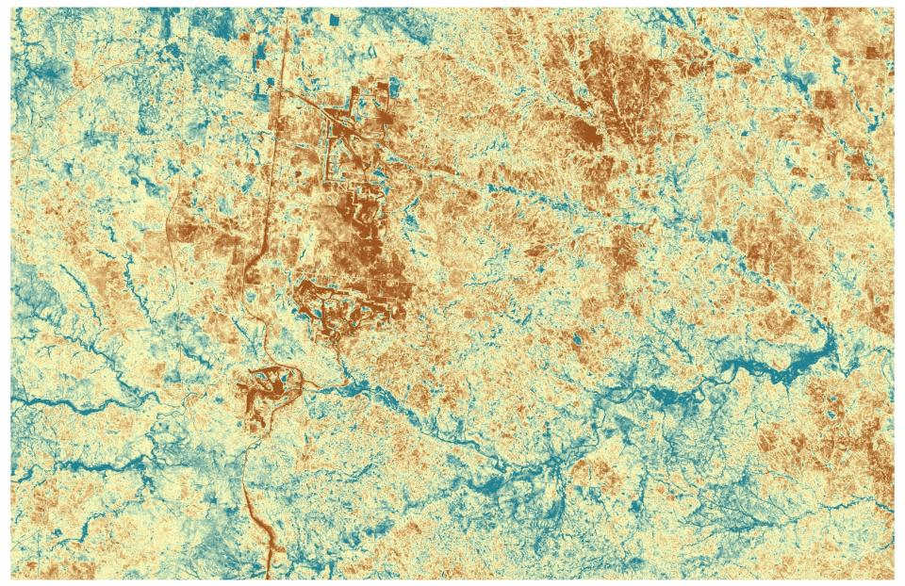
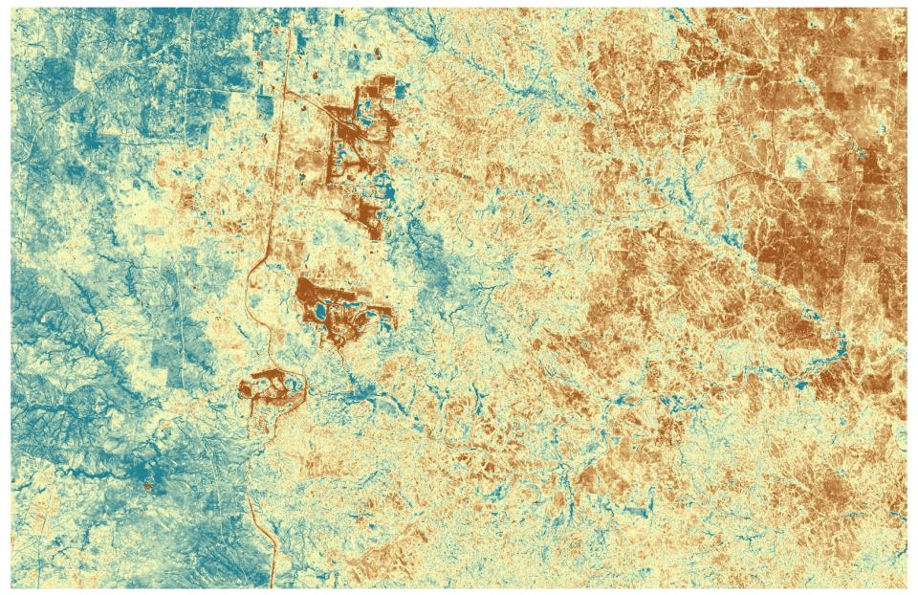
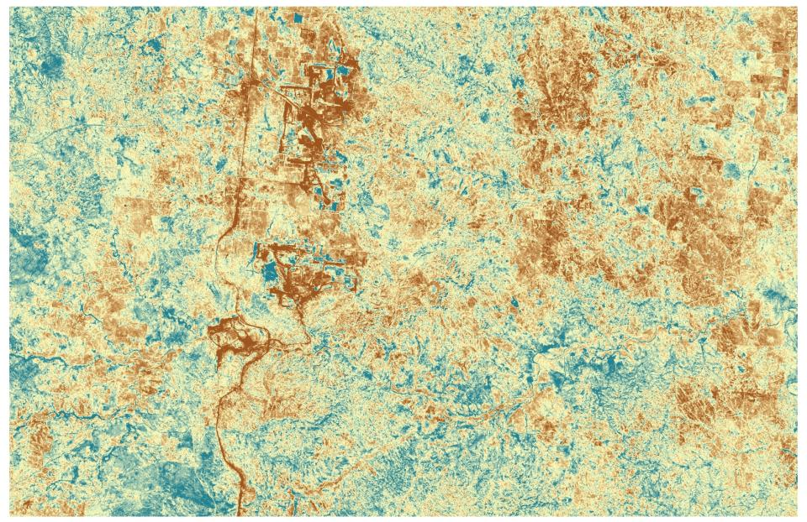
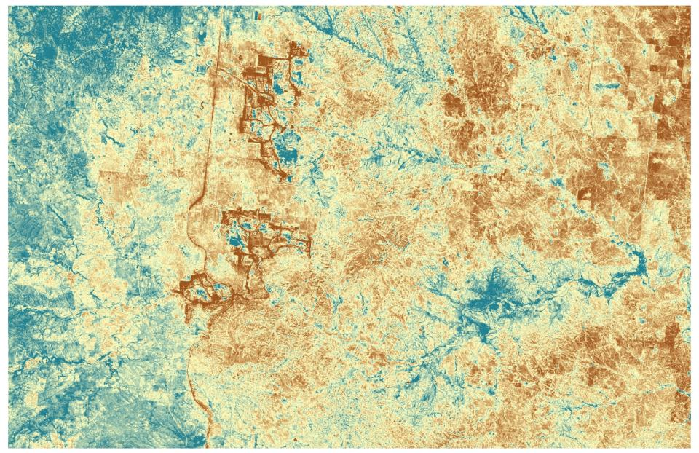
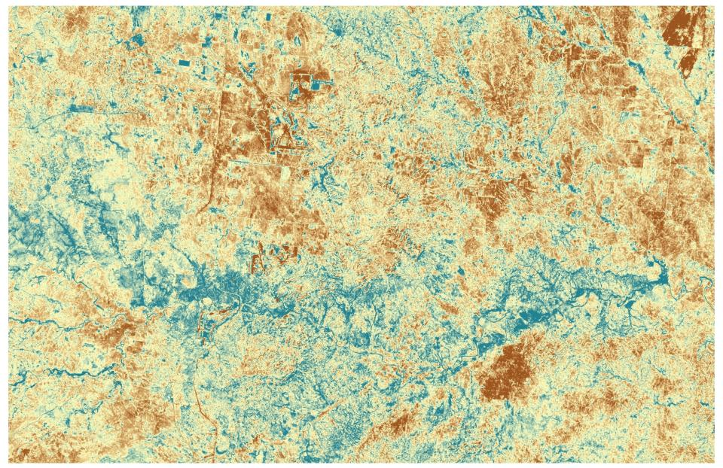
MSAVI Animation 1990-2007
1990
1997
2000
2002
2003
2006
2007
1994

Slide 7


1994
MSAVI
1994 & 2007
2007
NDVI corrected for soil brightness
Not biased by vegetation senescence

Slide 8
Entropy
Information content in random variable
H = -∑(P_{i}*ln(P_{i}))
Where: P_{i} = Proportion of one value to total values P_{i}=n(p)/m
m = number of unique values
Maximum entropy is achieved when all values are different or ln(m)
Need integer (nominal) data

Slide 9
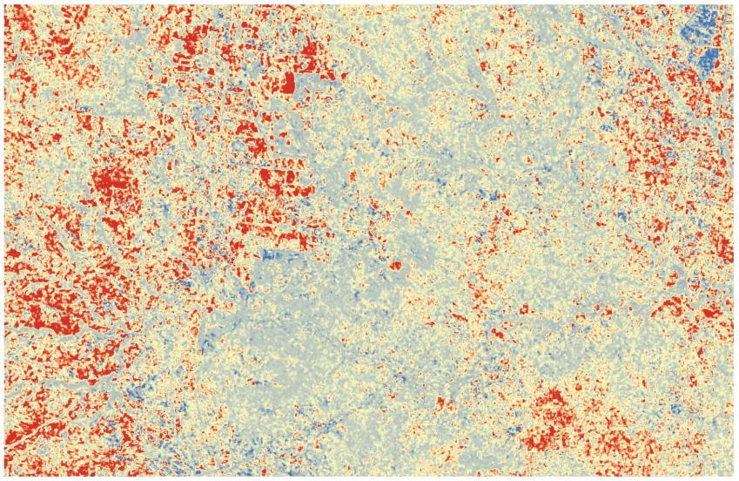
Entropy results

Slide 10
Fuzzy Set Theory
Calculates similarity distance matrix using 1-|a-b| / max[a,b] thus taking into account that there are “gradients of similarity” between times

Slide 11
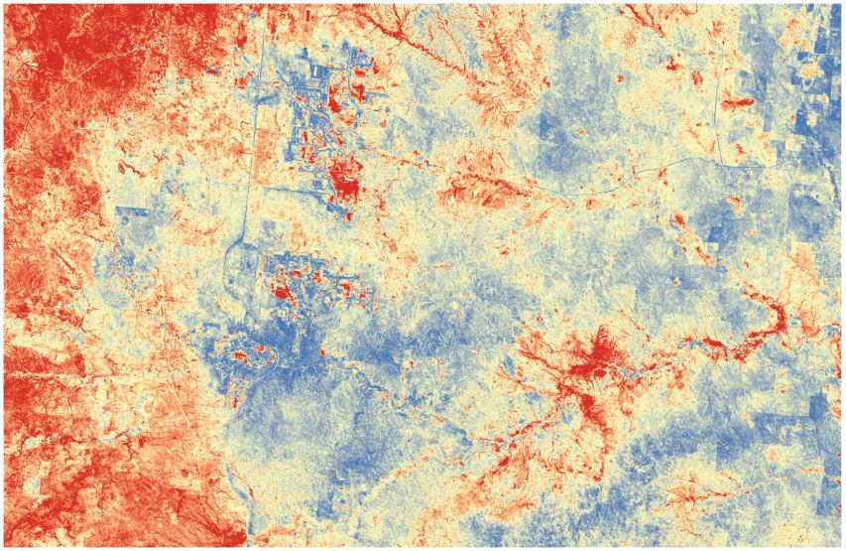
Fuzzy Set results

Slide 12
Bivariate autocorrelation
Moran’s-I (-1 to 1)
Bivariate version compares against a second variable rather than a self-lagged variable
Global coefficient is localized within specified radius
Juxtaposition of (1) high/low or (-1) low/high values.
Identifies outliers (hot spots)

Slide 13
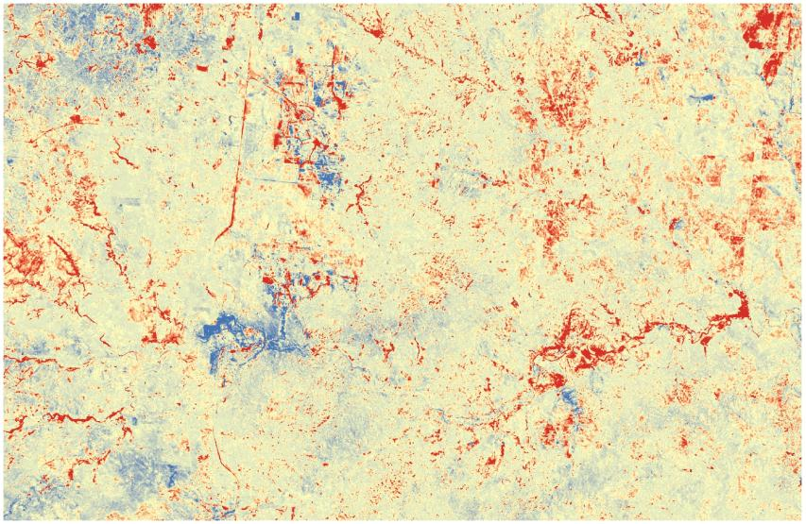
Bivariate autocorrelation results

Slide 14
Statistical time series models on observational data

Slide 15
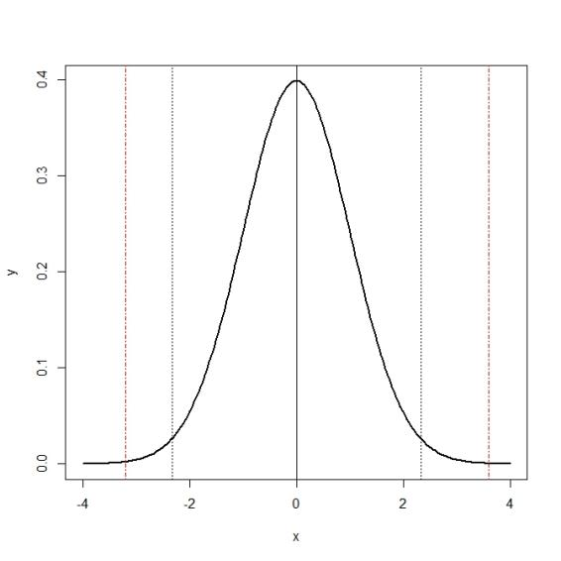
Normal distribution
-1 SD
+1 SD
10th
95th
Mean

Slide 16
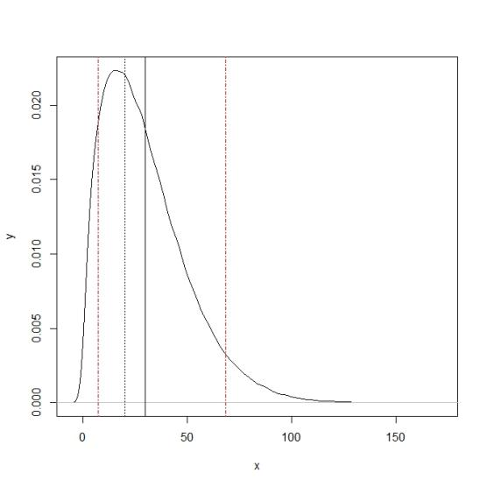
Non-normal (skewed) distribution
+1 SD
95th
10th
Mean

Slide 17
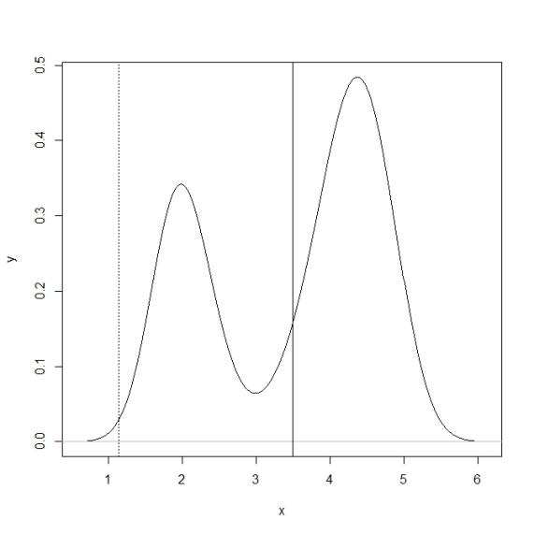
Non-normal (Multi-modal) distribution
Mean
+1 SD

Slide 18
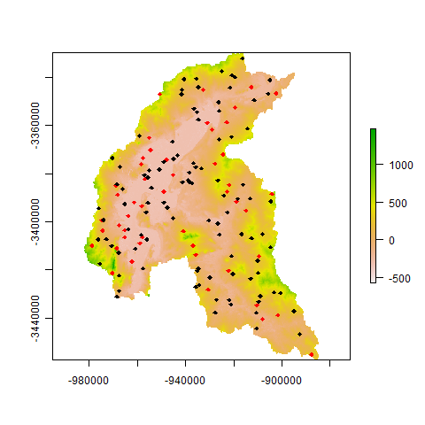
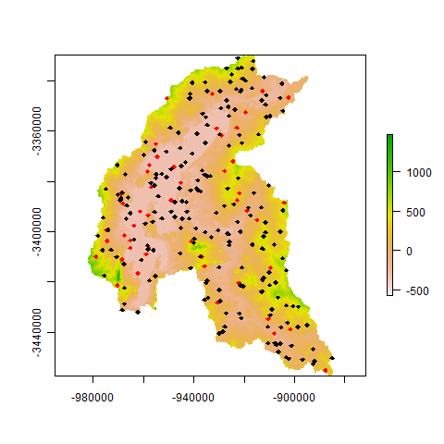
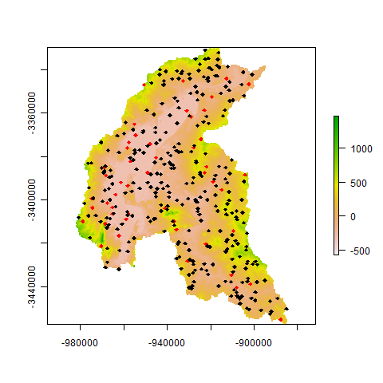
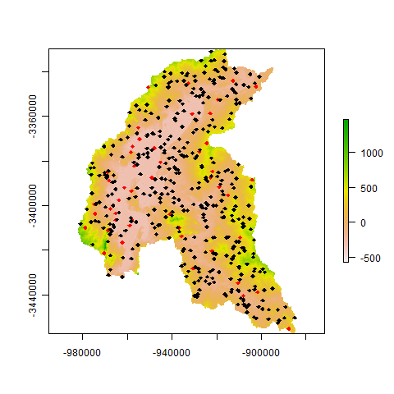
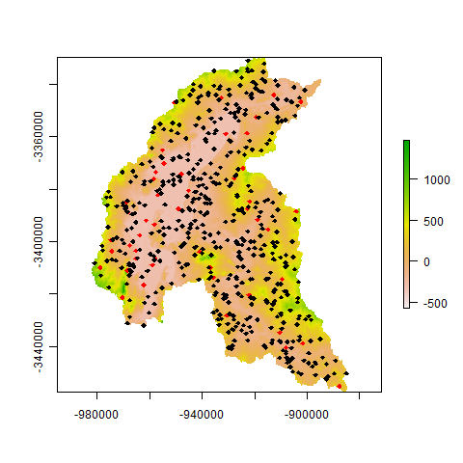
Spatial Variability

Slide 19
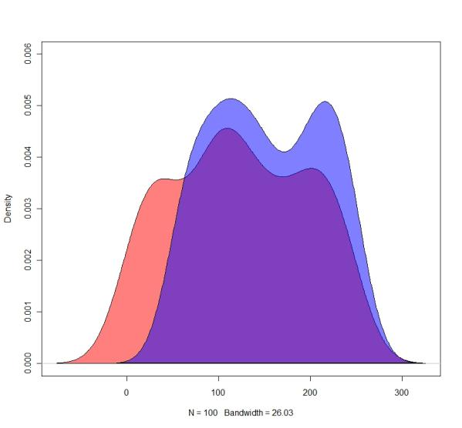
Statistical Variability
Capturing population distribution in sample
Range of variability
Influences quality of model
Blue - Sample distribution
Red - Population distribution
Captured
variability
Missing variability

Slide 20
Time series analysis
It is assumed that the data consist of a systematic pattern (cycle or trend)
Stochasticity and random noise can make the pattern difficult to identify
Very often non-linear data series
Most approaches involve some form of filtering in order to make the pattern more salient.

Slide 21
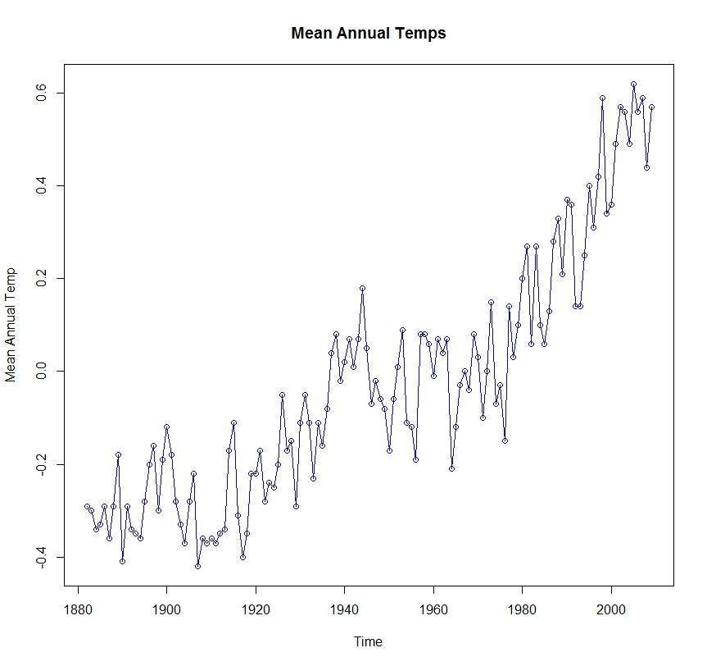
Time series

Slide 22
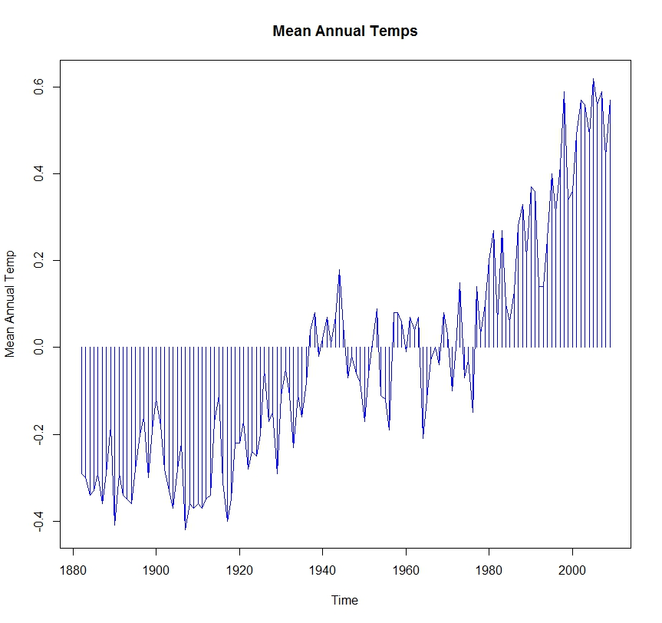
Time series (centered on 0)

Slide 23
Why not use OLS on time series data?
OLS estimates are sensitive to outliers.
OLS attempts to minimize the sum of squares for errors; time series with a trend will result greater weights on the first and last observations.
OLS treats the regression relationship as deterministic, whereas time series have stochastic characteristics.
We should not treat temporal dynamics as a nuisance but, rather draw inference from them.

Slide 24
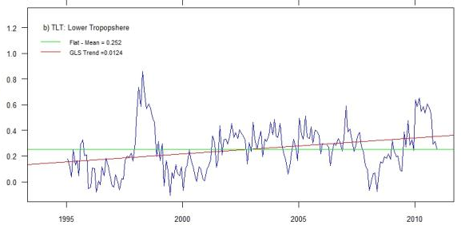
The danger of eyeball “inference”

Slide 25
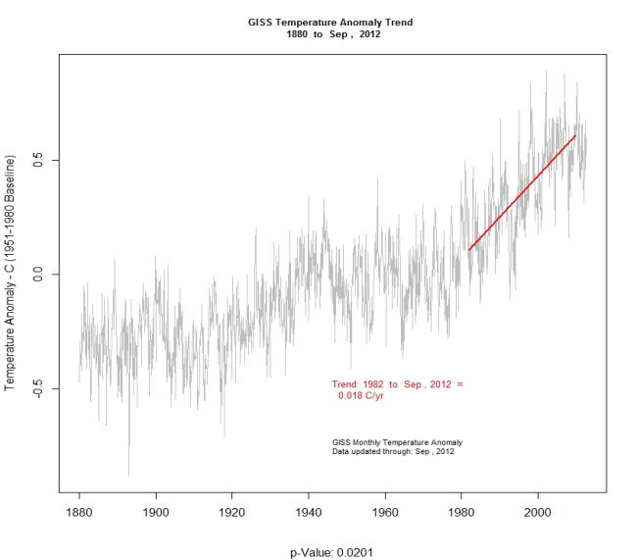
Trend in periodic patterns

Slide 26
Naïve Methods - Rate of Change
Rate or magnitude of change between two time periods
roc = [(date 1 – date 2) / date 1 * 100]
Does not capture true trend nor represent all of the data!

Slide 27
Trend analysis
Fit linear or nonlinear trend to data
Smoothing - replaces each element of the series by either the simple or weighted average of n surrounding elements
Function - approximated linear function using transformation of linear model

Slide 28
Smoothing – Linear and nonlinear trend
Moving Window - Simple smoothing using n^{th} order neighbors
Spectral analysis - Analysis of density in periodicity (cycles in time series)
Wavelet analysis – Flexible multiscale approach for fitting to an expected distribution

Slide 29
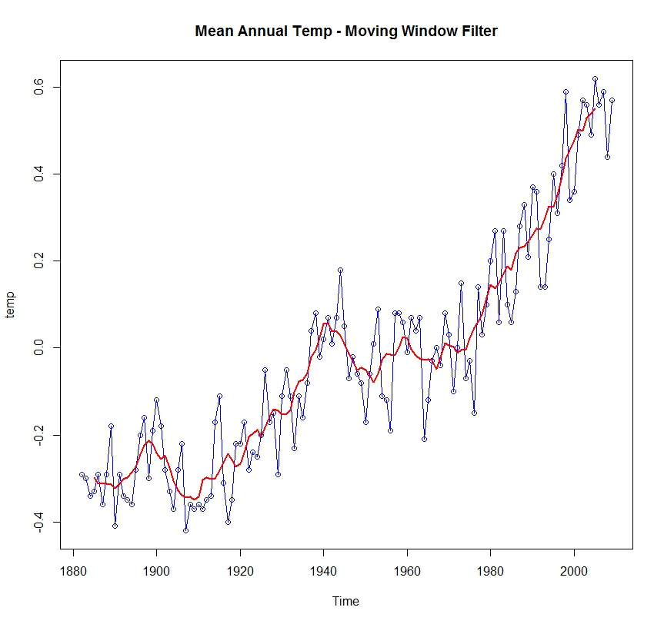
Time series with moving window trend

Slide 30
Regression – Linear and nonlinear trend
Ordinary Least Squares – Vanilla linear regression (time ~ x)
Mixed Effect Models – Uses an autoregressive ARIMA(I) term to account for serial autocorrelation (required for forecasting)
Splines – Semiparametric approach that can fit nonlinear trend
Lowess – Nonparametric polynomial regression that can fit nonlinear trend

Slide 31
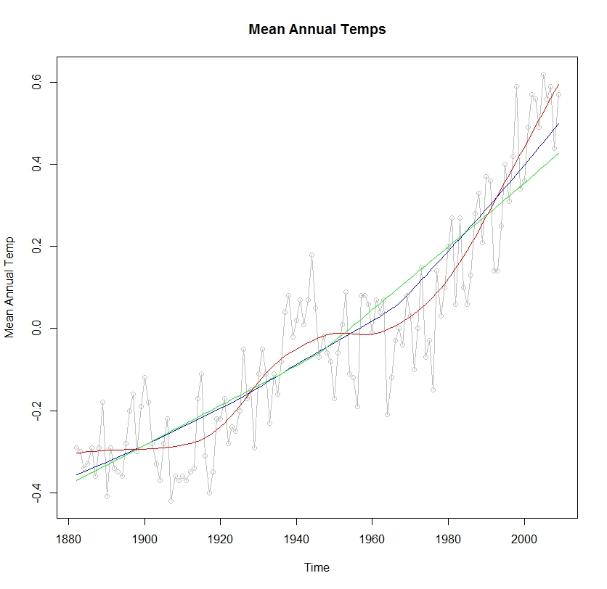
Time series with lowess regression

Slide 32
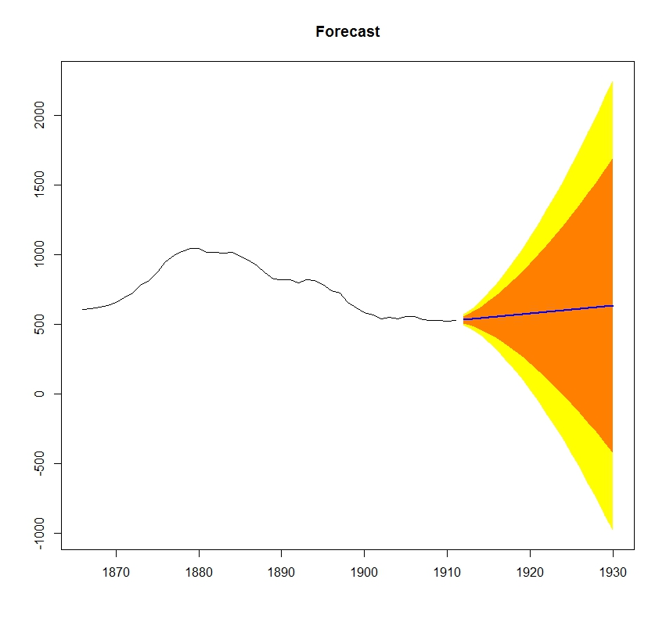
Forecasting with ARIMA(I)

Slide 33
Serial autocorrelation
Higher correlation with observations closer in the time series
Violates assumptions of independence
can bias trend
Can sometimes be corrected by normalization.
subtracting the mean and dividing by the variance
(x –mean(x))/var(x)
Avoided by using “nonparametric” approaches

Slide 34
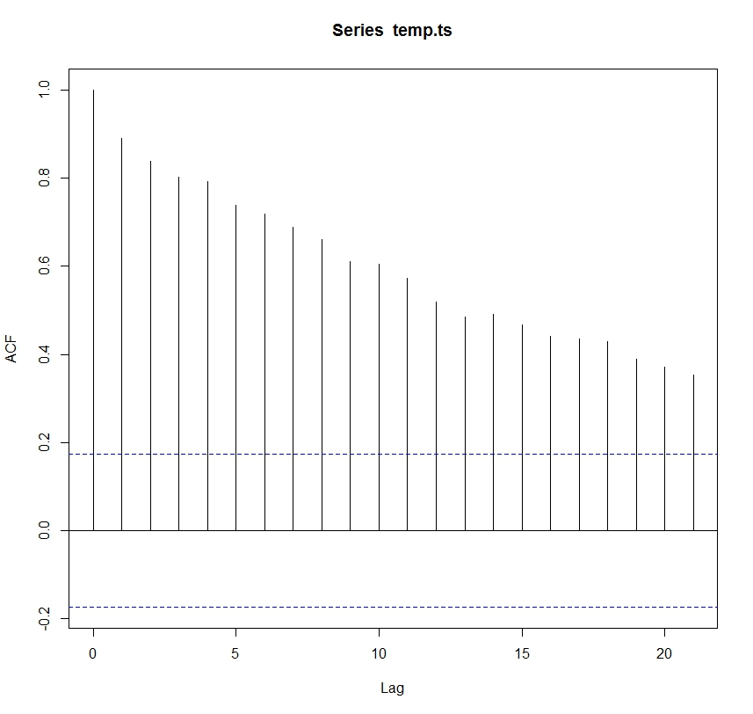
Serial autocorrelation

Slide 35
Seasonal variation (periodicity)
Decomposition - Isolates components, that is, to “decompose” the series into the trend effect, seasonal effects, and remaining variability
Spectral analysis - Analysis of underlying sinusoidal (sine and cosine) functions in periodicity (cycles in time series)
Census I - Separates “cycles” from overall trend
Periodic moving averages – Performs a moving average smoothing, conditional on cyclide variation

Slide 36
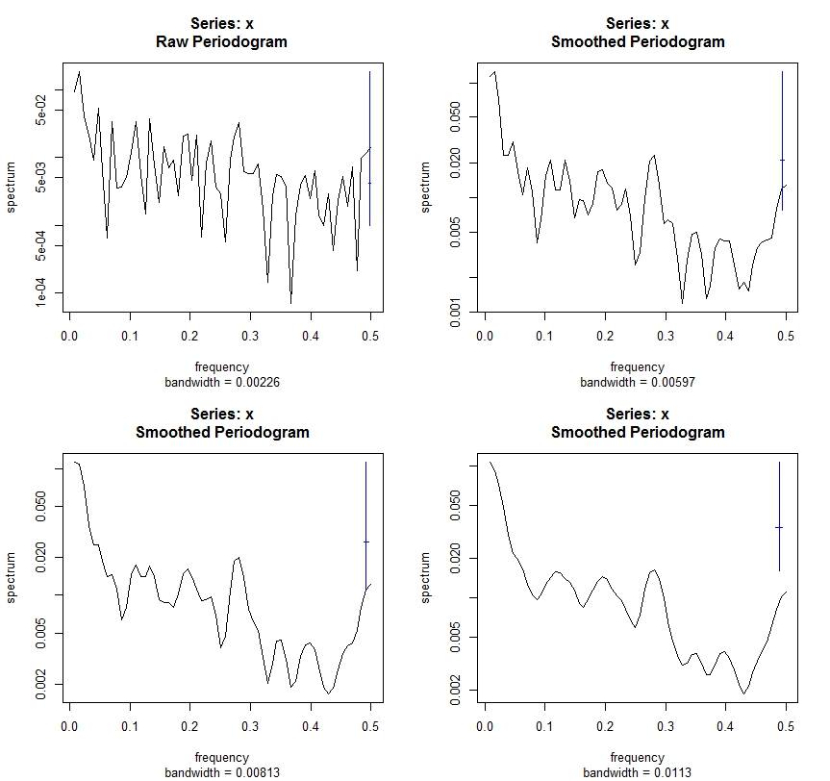
Spectral analysis

Slide 37
Example Monitoring analysis framework

Slide 38
Generate stratified sample
Sum MSAVI across all years to account for variation
Classify summed MSAVI into three classes to represent our stratification
Create a “variable” random sample and assign stratified values
Assign values from each MSAVI year
Aggregate values within each strata so we end up with a single value per-strata, per-year.

Slide 39
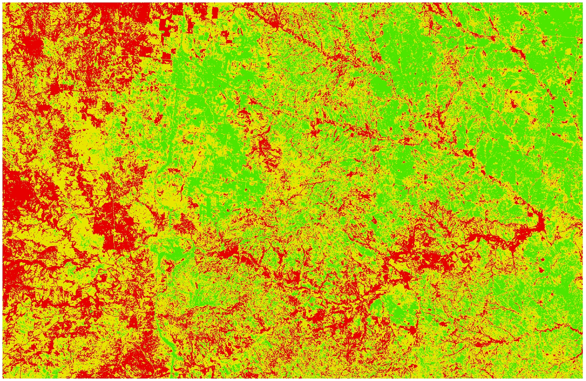
Stratified raster

Slide 40
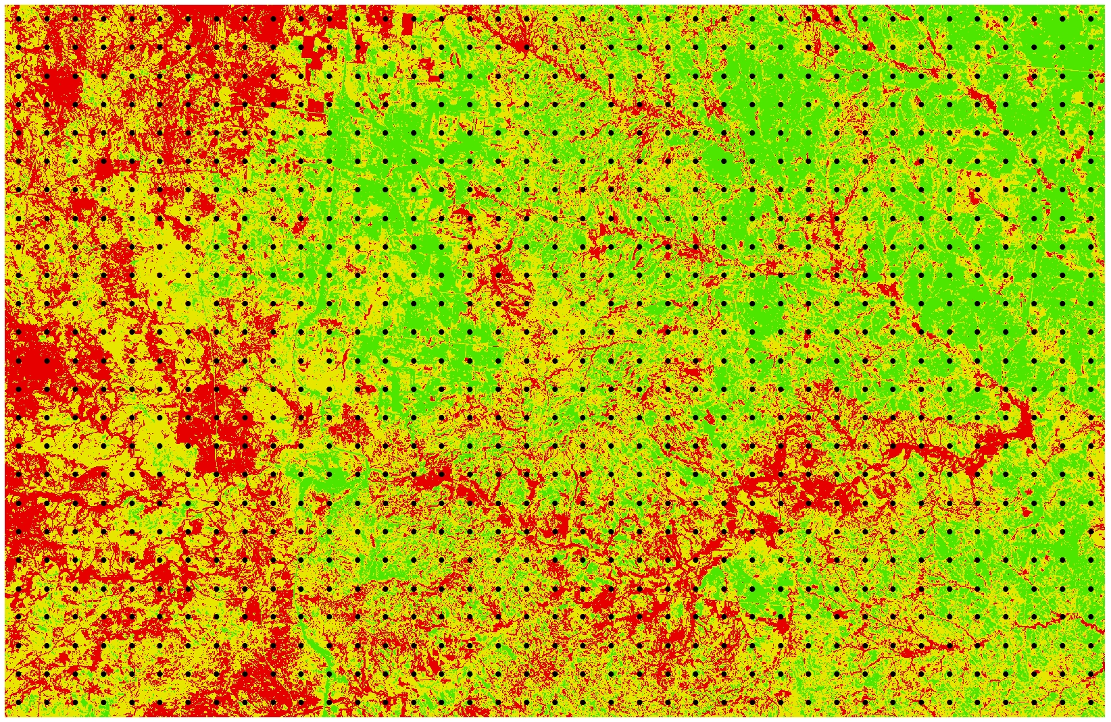
Stratified raster with variable sample

Slide 41
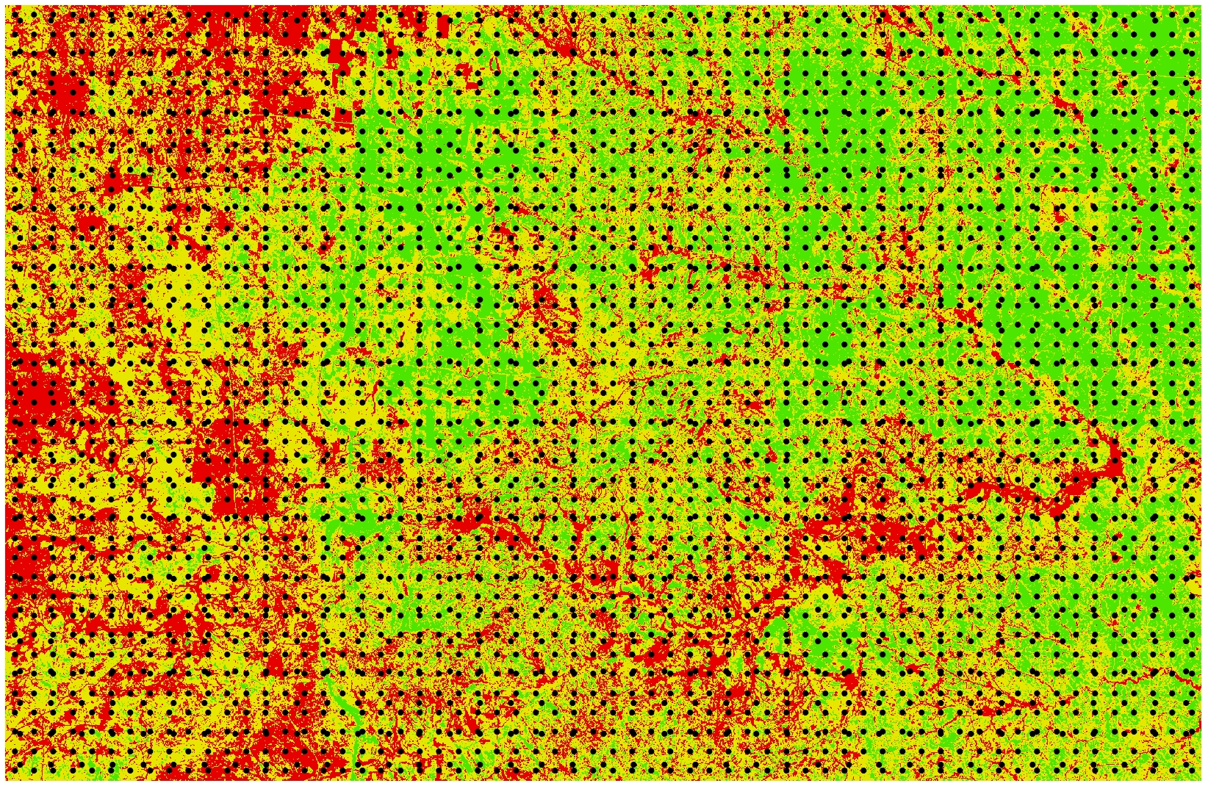
Stratified raster with variable sample

Slide 42
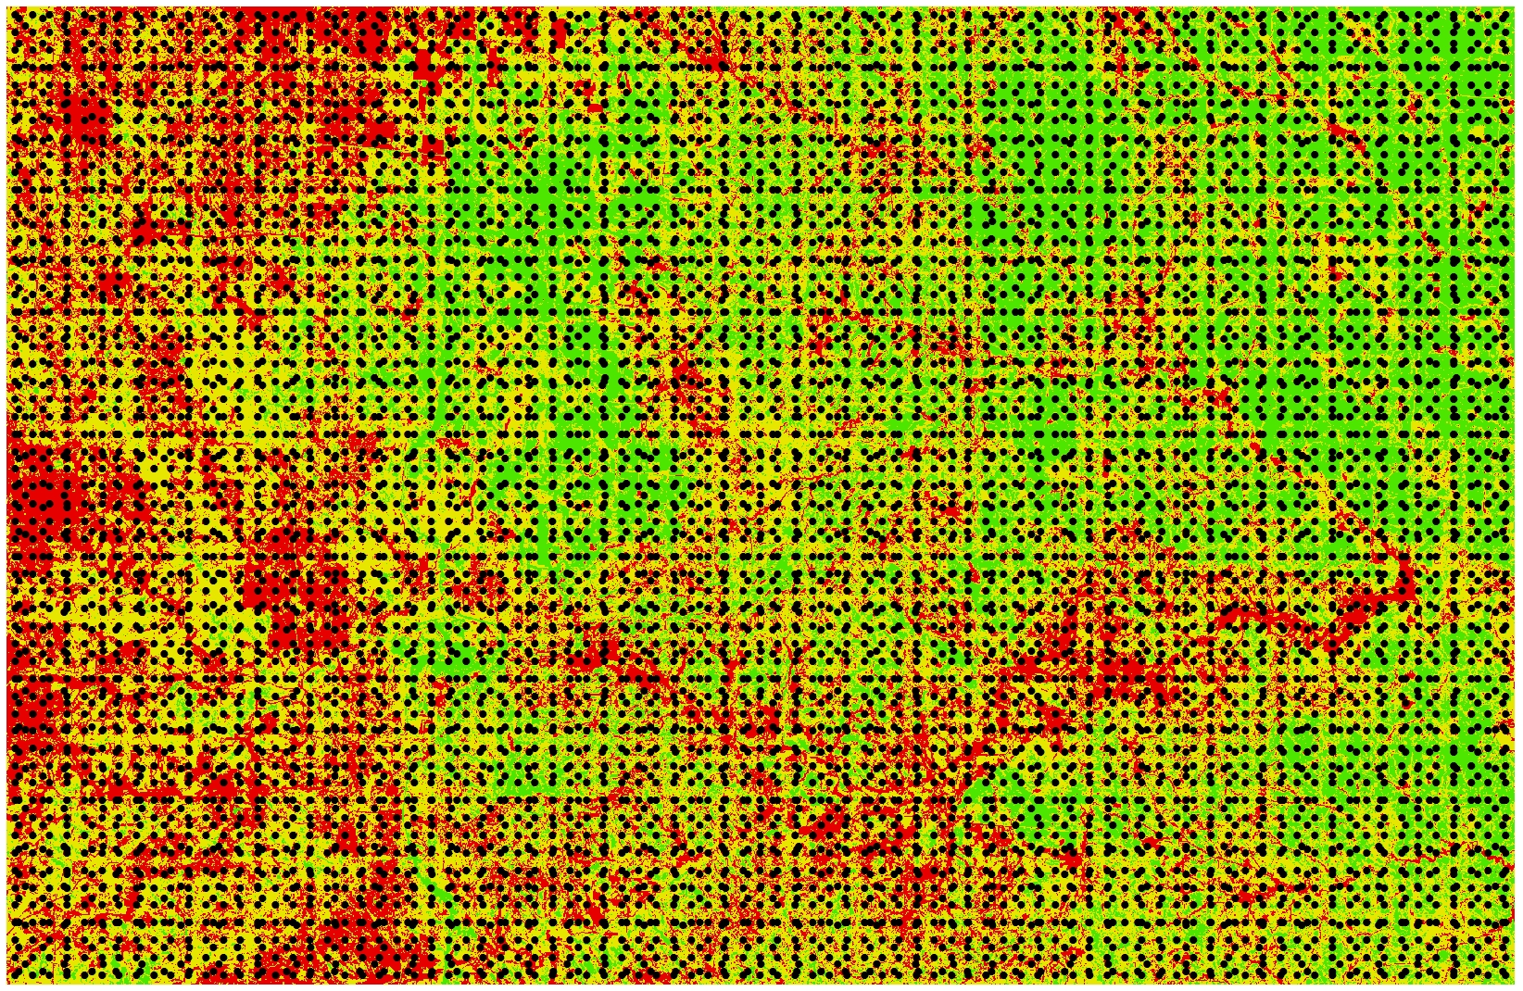
Stratified raster with variable sample

Slide 43
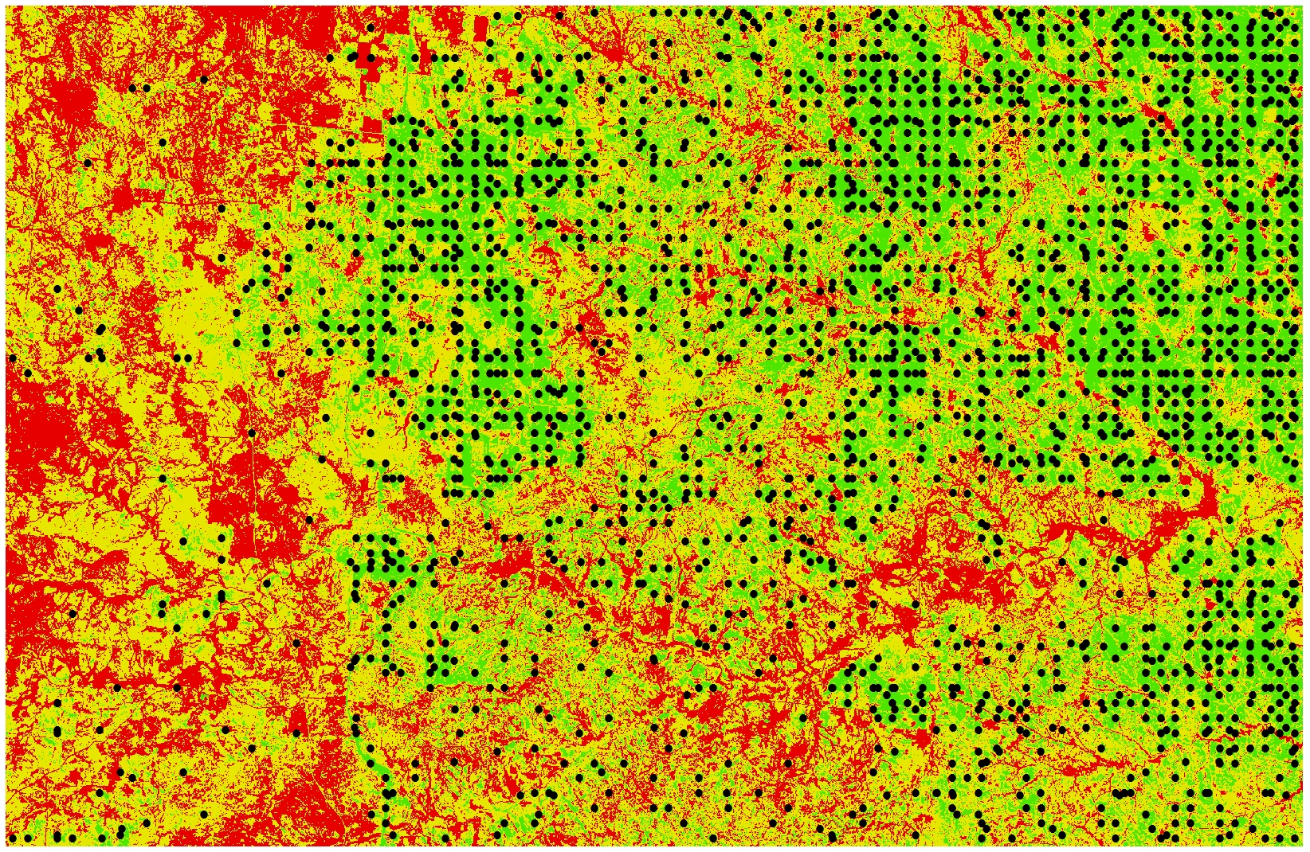
Strata 3

Slide 44
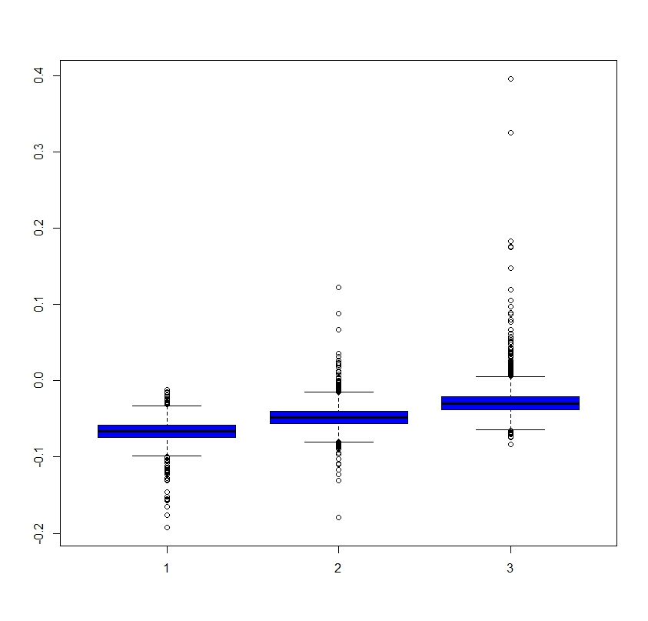
Box plot of strata

Slide 45
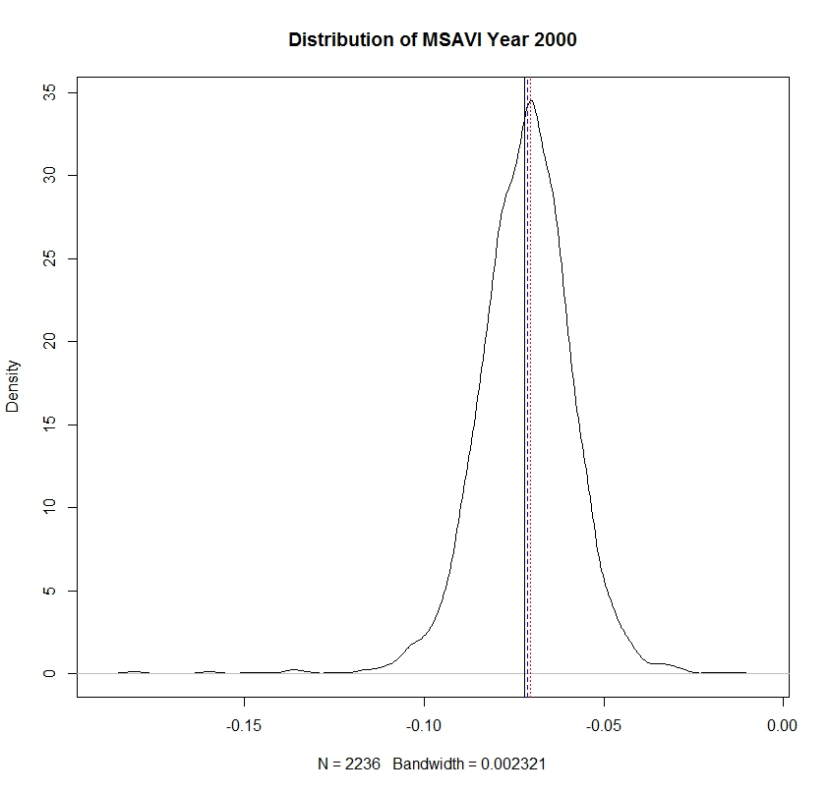
Probability distribution of strata 3 – y2000

Slide 46
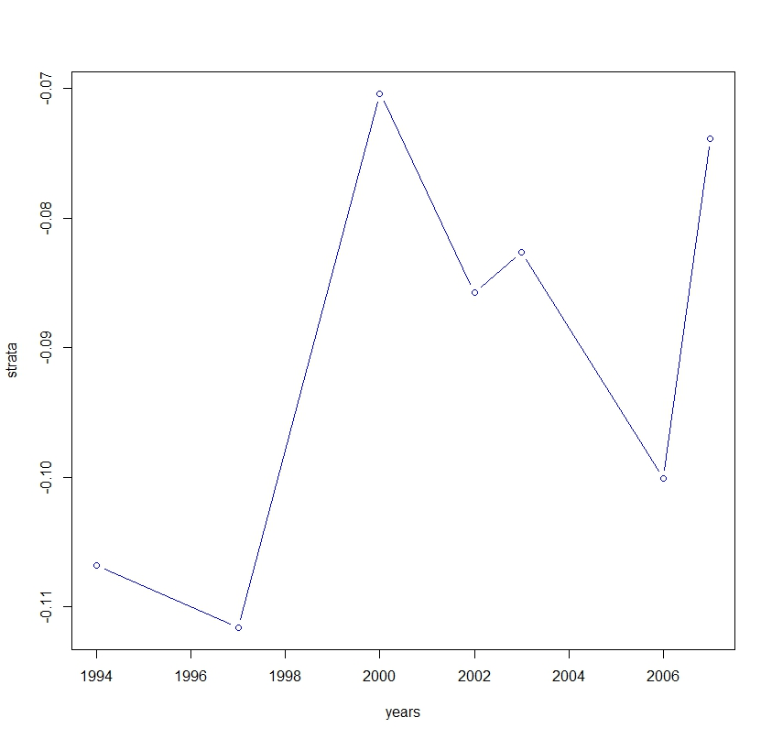
Time series of MSAVI in strata 3

Slide 47
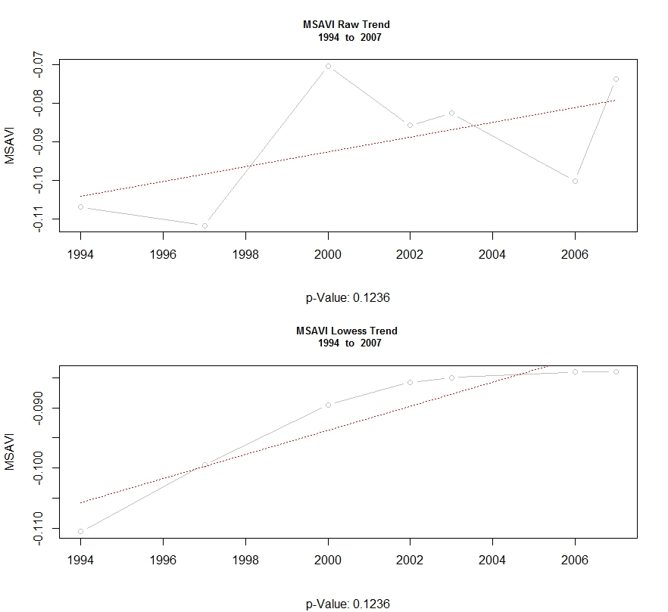
MSAVI in strata 3 - GLM & Lowess

Slide 48
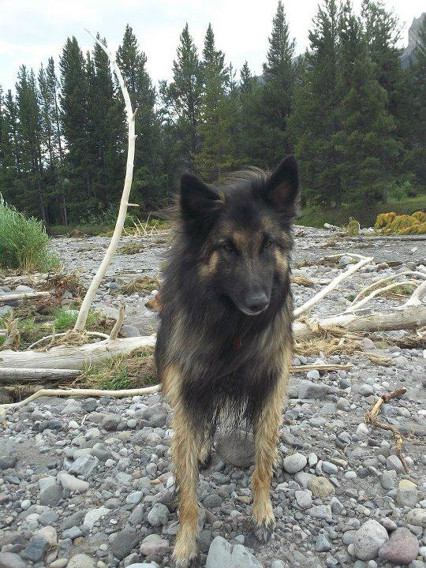
Questions

